Slide 1
Attitudes and Job Satisfaction

Slide 2
Attitudes
Evaluating statements or judgments concerning objects, people, or events
Why do we care?
Attitudes → Behavior
Performance, absenteesm, turnover, OCB, etc…

Slide 3
Three Components of an Attitude
Affective
Cognitive
Behavioral
Attitude
The emotional
or feeling
segment of an
attitude
The opinion or belief segment of an attitude
An intention to behave in a certain way toward someone or something

Slide 4
Does Behavior Always Follow From Attitudes?
Consistency seeking
Incompatibility → uncomfortable feeling
→ trying to reduce CD

Slide 5
Major Job Attitudes
Job satisfaction
Positive feeling about job

Slide 6
Major Job Attitudes
Job Involvement
Psychological Empowerment
→ Job performance, OCB

Slide 7
Major Job Attitudes
Organizational Commitment
Identifying with a particular organization and its goals
→

Slide 8
Major Job Attitudes
Perceived Organizational Support (POS)
employees believe the organization values them
→

Slide 9
Job Satisfaction
A positive feeling about a job resulting from an evaluation of its characteristics

Slide 10
The Impact of satisfaction on employees
Job Satisfaction
→ Job Performance
→ OCB
→ Customer Satisfaction
→ Absenteeism
→ Turnover
→ Workplace Deviance

Slide 11
Job Satisfaction
Pay influences job satisfaction only to a point.

Slide 12
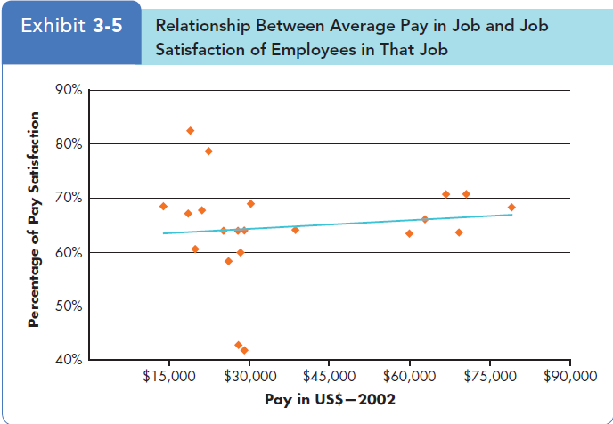
Job Satisfaction

Slide 13
Job Satisfaction
Pay influences job satisfaction only to a point.
$40,000 per year (in the U.S.)
Money may bring happiness, but not necessarily job satisfaction.

Slide 14
Other factors
Age
Young > old
Personality

Slide 15
Other factors
Job Conditions
Nature of the work
Social interactions
Supervision

Slide 16
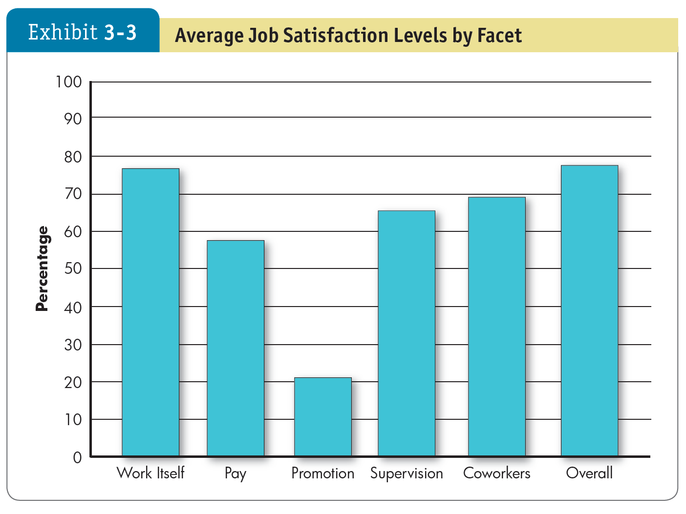
Other factors

Slide 17
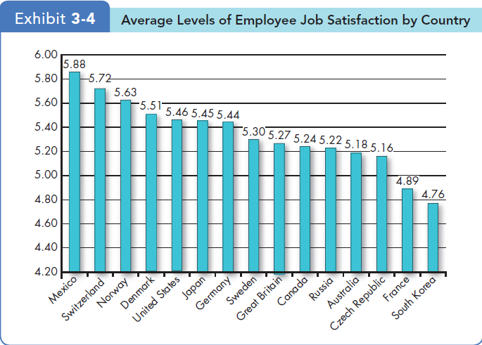
Other factors
Culture
Insert Exhibit 3-3

Slide 18
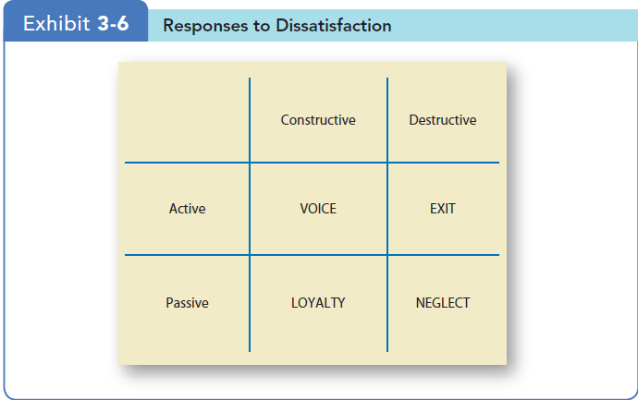
Employee Responses to Dissatisfaction
3-18

Slide 19
Implications for Managers

